Slide 1
MySQL 간단한 사용법

Slide 2
USE [db_name]
SHOW [databases/tables]
CREATE / DROP [database/table]
DESC [table]
INSERT into [table] values [values]
UPDATE / DELETE
SELECT [what] from [table] [where condition]
NOTE that “;” means the end of sentence

Slide 3
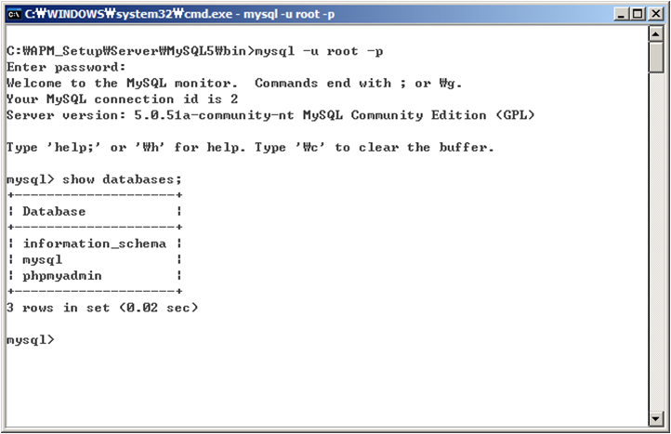
“mysql –u [user] –p [password]”

Slide 4
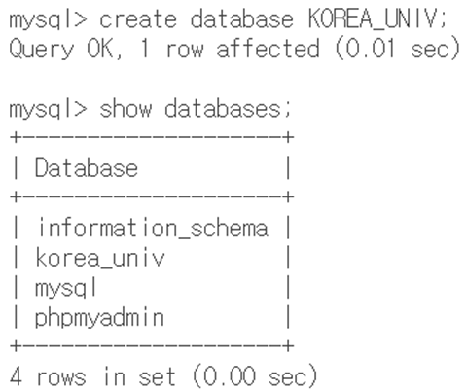
Using “CREATE DATABASE [dbname];”

Slide 5
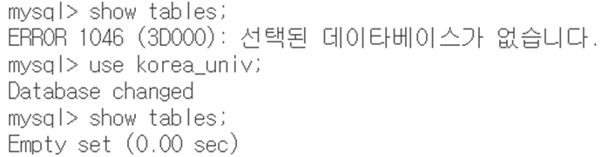
“use [dbname];”
“show tables;”

Slide 6
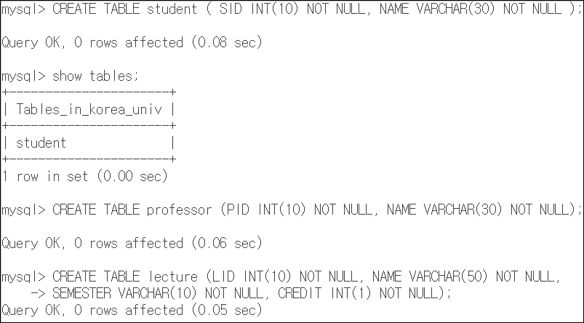
CREATE TABLE [table_name] (fieldname type(length)…);

Slide 7
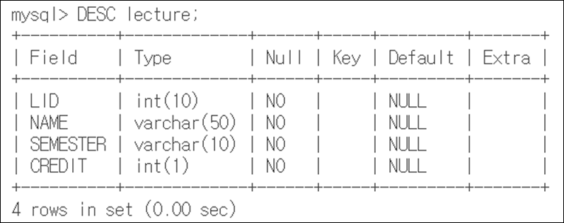
DESC [table_name]: Description of a table
“show tables” shows all table list

Slide 8
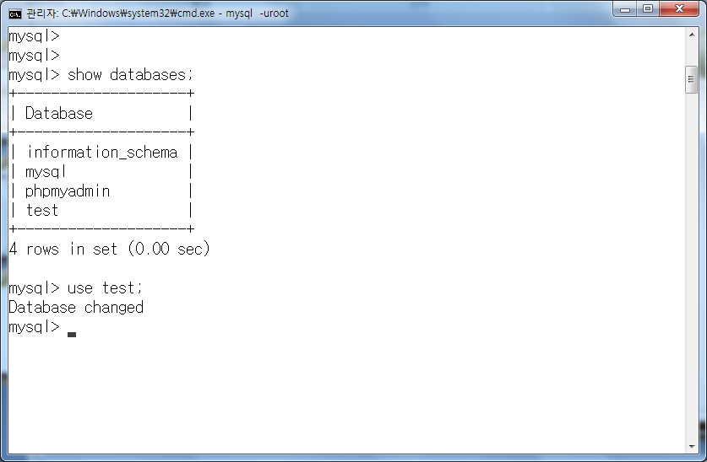
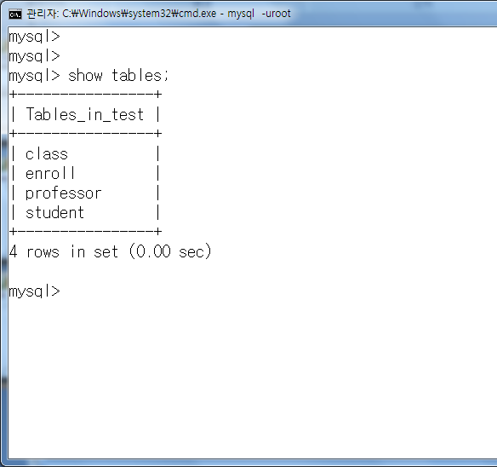

Slide 9
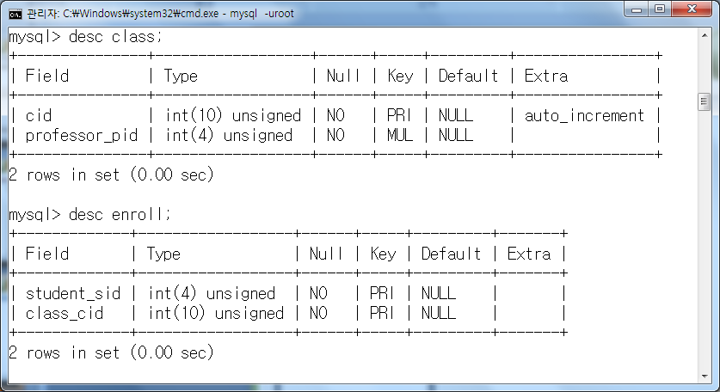

Slide 10
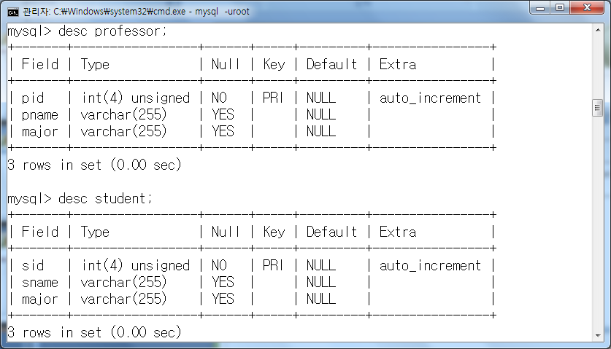

Slide 11
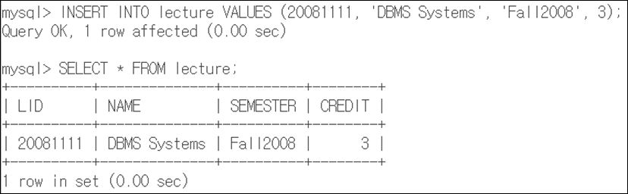
INSERT INTO [table_name] VALUES [VALUES]
Insert a new tuple to the table
SELECT * FROM [table_name]
Shows every tuples in the table

Slide 12
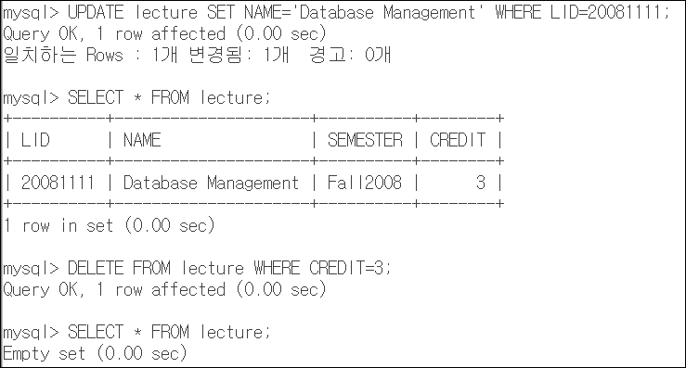
UPDATE [table] SET [what] WHERE [condition]
Modify the value of existing tuple
DELETE FROM [table] WHERE [condition]

Slide 13
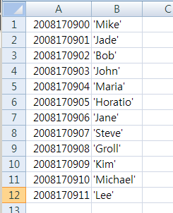
Insert multiple tuples at a time!
Suppose we have a list of students created using the Excel.
to move all the information into MySQL database, we use the bulk insert

Slide 14
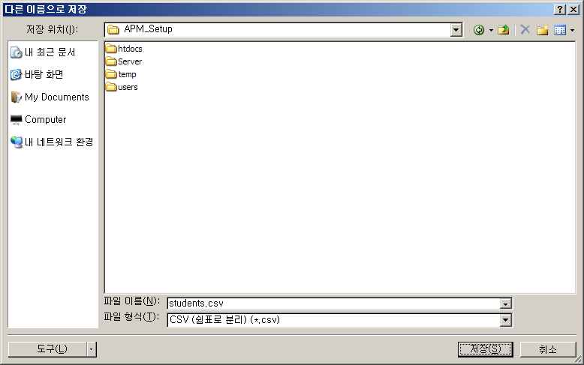
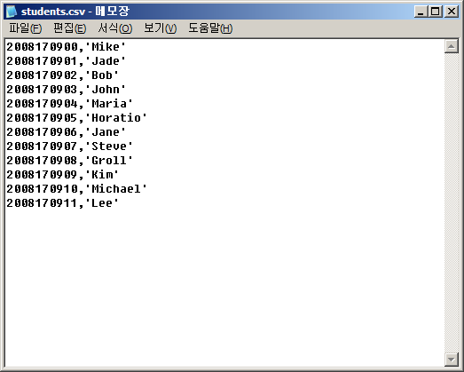
Save as “CSV” format

Slide 15
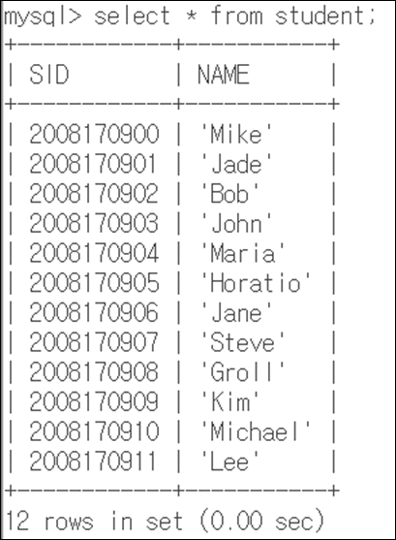
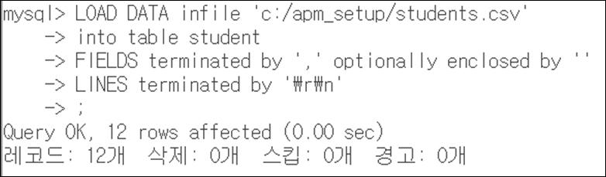
LOAD DATA: bulk loading operation

Slide 16
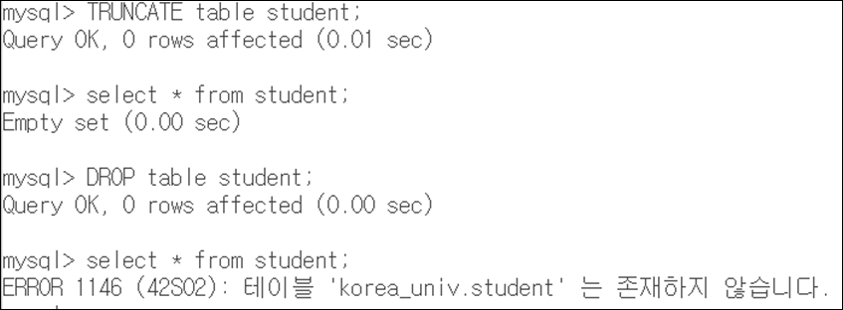
TRUNCATE table [tablename]
Truncate operation keeps the schema of table
DROP table [tablename]
Remove all information about table including schema

Slide 17
End…

